Slide 1

Confidence Intervals for One Sample
Chapter 8

Slide 2
Objectives
Study sections 8.1 – 8.3.
Understand the interpretation of a confidence interval.
Know how to build a confidence interval using R Studio.
Understand how to choose the appropriate method for building a confidence interval, given the information provided.
Know how to calculate critical z- and t- values.
Calculate minimum sample sizes for future studies.

Slide 3
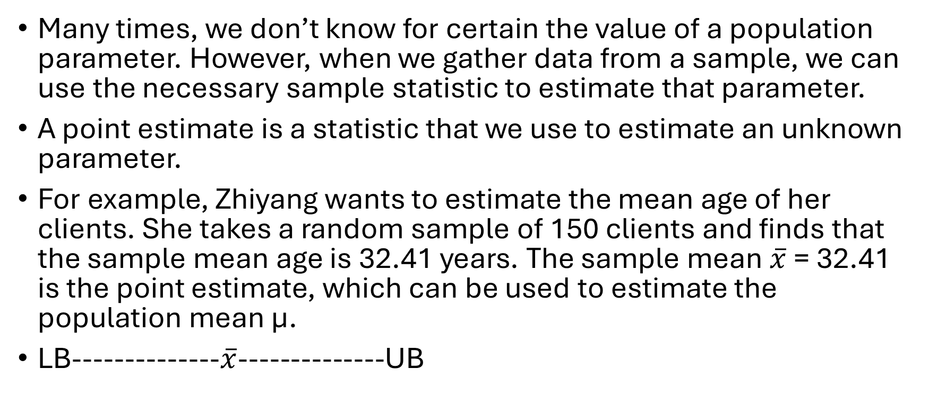
Confidence Intervals for Means (σ known)
Many times, we don’t know for certain the value of a population parameter. However, when we gather data from a sample, we can use the necessary sample statistic to estimate that parameter.
A point estimate is a statistic that we use to estimate an unknown parameter.
For example, Zhiyang wants to estimate the mean age of her clients. She takes a random sample of 150 clients and finds that the sample mean age is 32.41 years. The sample mean $\overline{x}$ = 32.41 is the point estimate, which can be used to estimate the population mean µ.
LB--------------$\overline{x}$--------------UB

Slide 4
Confidence Interval Template
lower boundary -------------- point estimate -------------- upper boundary
(LB, UB)

Slide 5
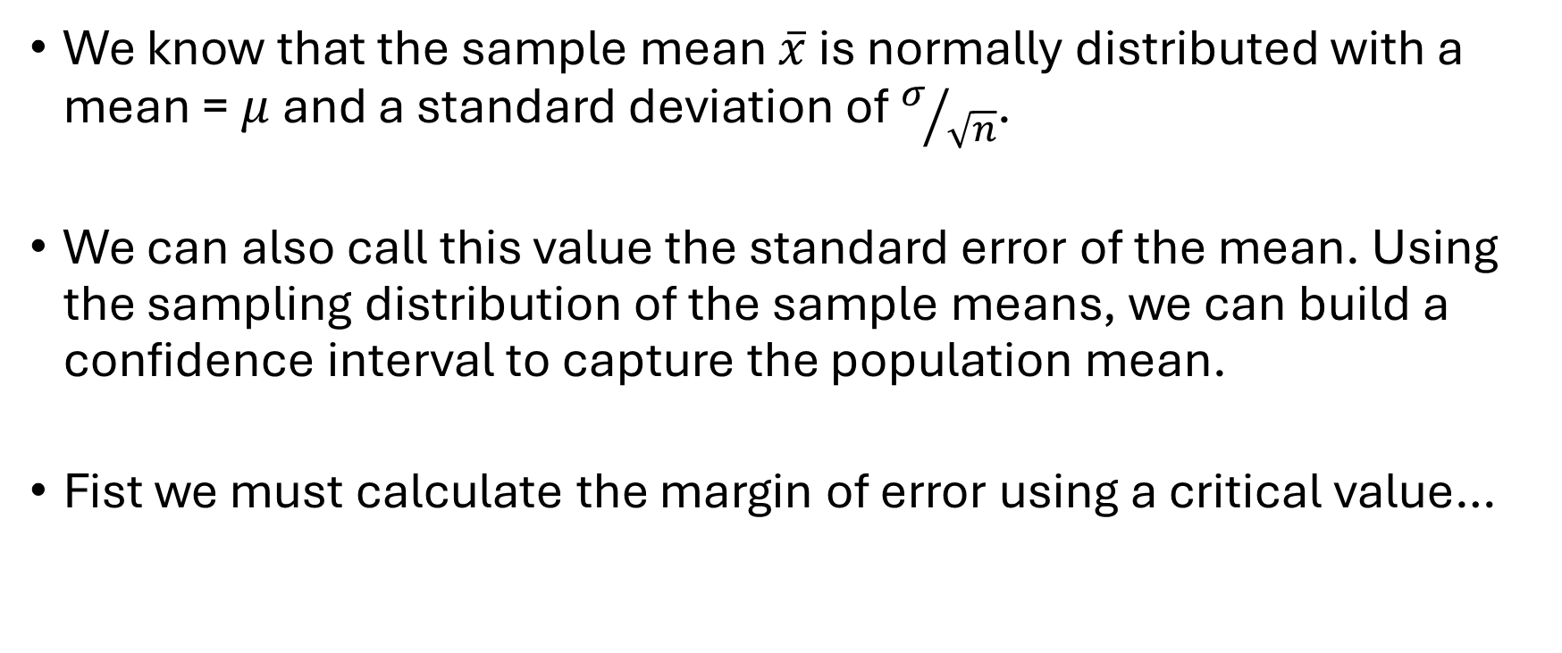
Using the Central Limit Theorem
We know that the sample mean $\overline{x}$ is normally distributed with a mean = $μ$ and a standard deviation of $σ/{\sqrt{n}}$.
We can also call this value the standard error of the mean. Using the sampling distribution of the sample means, we can build a confidence interval to capture the population mean.
Fist we must calculate the margin of error using a critical value…

Slide 6
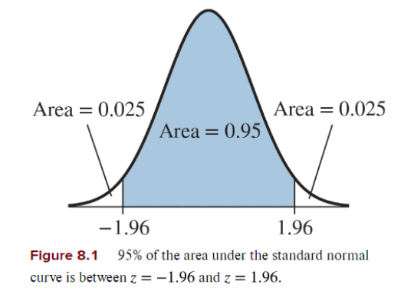
Finding Critical Values
A critical value is a cut-off value that is
determined by our desired confidence level.
For example, if we want to build a 95%
confidence interval, then the area to the right
of our critical z-score is 0.025. That z-score is
1.96, our critical value.
qnorm(0.025, 0, 1, lower.tail = FALSE)
The confidence level ranges from 0% to 100% and measures the success rate of the interval in capturing the parameter of interest. Usually we use 90%, 95%, and 99%.

Slide 7
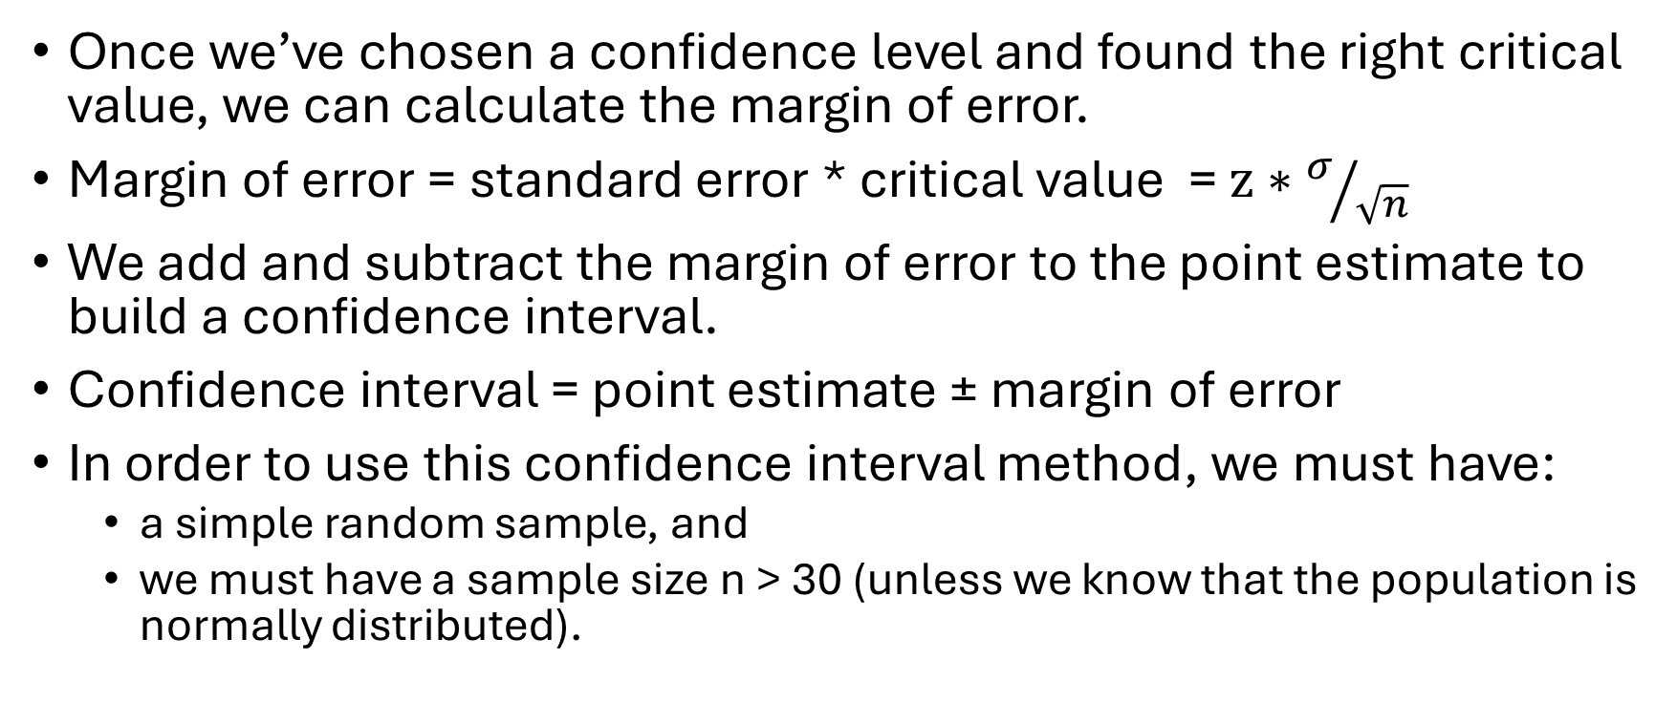
The Margin of Error
Once we’ve chosen a confidence level and found the right critical value, we can calculate the margin of error.
Margin of error = standard error * critical value = $z∗σ/{\sqrt{n}}$
We add and subtract the margin of error to the point estimate to build a confidence interval.
Confidence interval = point estimate ± margin of error
In order to use this confidence interval method, we must have:
  a simple random sample, and
  we must have a sample size n > 30 (unless we know that the population is normally distributed).

Slide 8
Battery Lifetime Example
The lifetime of a certain battery is known to be normally distributed with a population standard deviation of 20 hours. We take a random sample of 50 batteries. The sample mean lifetime is found to be 120.1 hours. Build a 95% confidence interval to estimate the population mean battery lifetime. *Be able to state the following components: point estimate, critical value, standard error, margin of error, lower and upper boundaries.

Slide 9
Battery Lifetime Solution
The lifetime of a certain battery is known to be normally distributed with a population standard deviation of 20 hours. We take a random sample of 50 batteries. The sample mean lifetime is found to be 120.1 hours. Build a 95% confidence interval to estimate the population mean battery lifetime.
Confidence interval = (114.56, 125.64)
We are 95% confident that the population mean battery lifetime is between 114.56 and 125.64 hours.

Slide 10
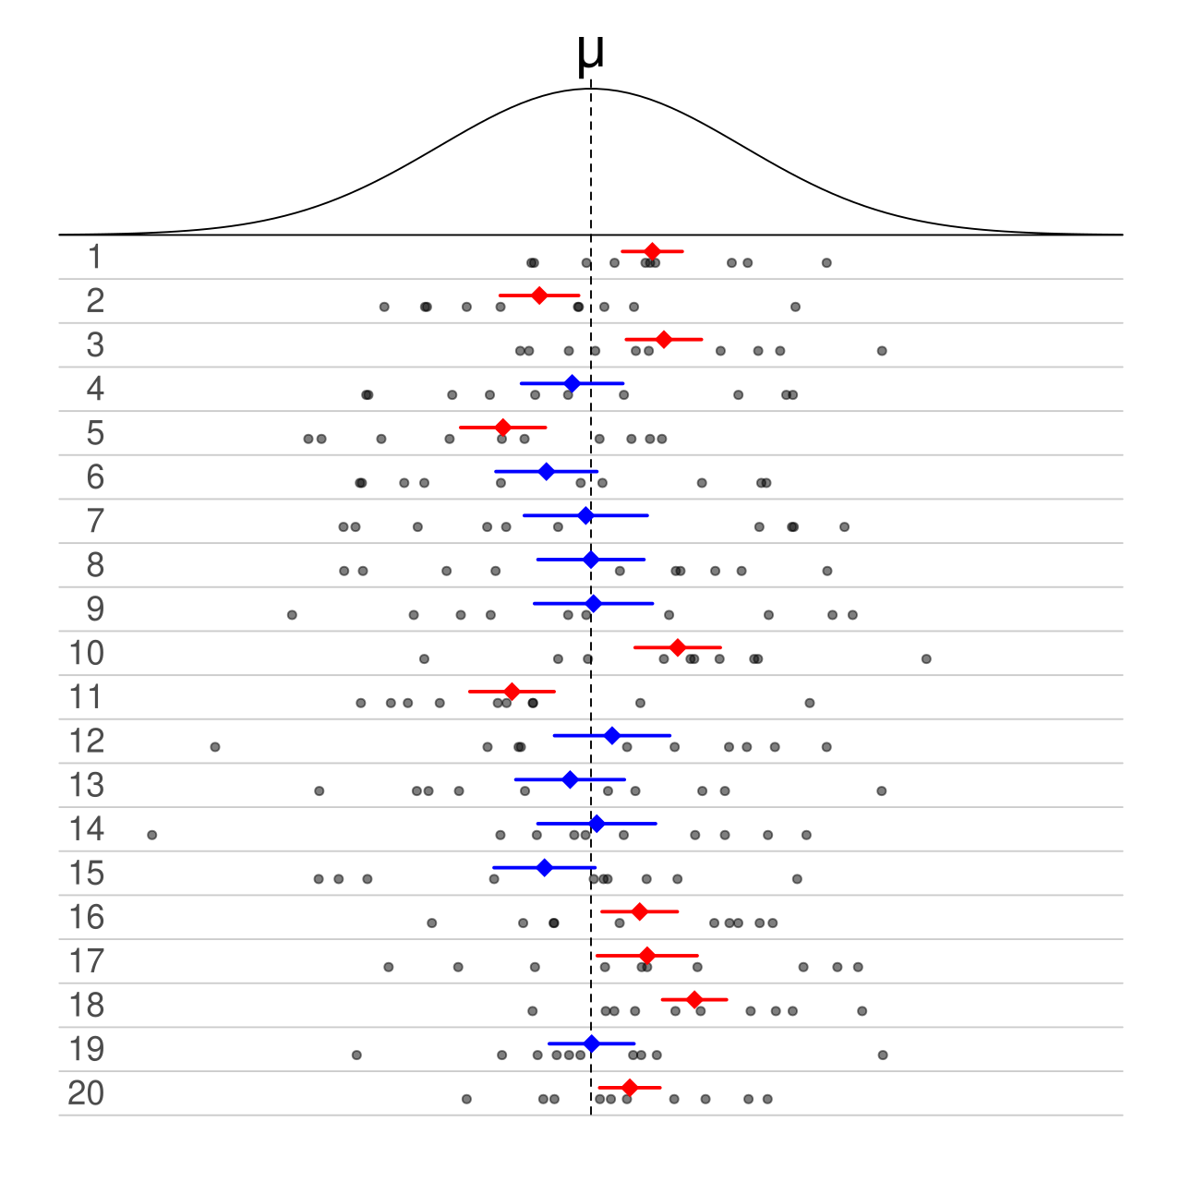
Interpreting Confidence Intervals for One Sample
Incorrect interpretation: There's a 95% chance the true parameter is inside the interval for our specific sample.
Correct interpretation: If we repeated the experiment over and over, 95% of the confidence intervals would contain the true parameter.

Slide 11
Credit Score Example
Credit scores are used by lenders to determine credit risk and range from 300 to 800. A loan officer samples 50 personal loans from the past year at a certain bank and finds the sample mean credit score to be 730. Assume that the population standard deviation is 40. Build a 99% confidence interval to estimate the population mean credit score. Is it likely that the population mean score at that bank is less than 600?

Slide 12
Credit Score Solution
Credit scores are used by lenders to determine credit risk and range from 300 to 800. A loan officer samples 50 personal loans from the past year at a certain bank and finds the sample mean credit score to be 730. Assume that the population standard deviation is 40. Build a 99% confidence interval to estimate the population mean credit score. Is it likely that the population mean score at that bank is less than 600?
(715.43, 744.57)
We are 99% confident that the population mean credit score for customers at this bank is between 715.4 and 744.6 points. Since the entire interval is above 600, it is not likely that μ is less than 600.

Slide 13
Changing the Confidence Level
Practice: Using the same credit score information, build a 90% confidence interval. What changed?

Slide 14
Changing the Confidence Level, continued
Using the same credit score information, build a 90% confidence interval. What changed?
(720.7, 739.3) = 90% interval
(715.4, 744.6) = 99% interval
Increased confidence level >>> larger critical value >>> larger margin of error >>> wider interval.
Decreased confidence level >>> smaller critical value >>> smaller margin of error >>> narrower interval.
*There is a trade-off in using confidence intervals to estimate parameters. We want a higher level of confidence, but with that comes a larger margin of error (a larger window of opportunity for an incorrect value). We want a smaller margin of error, but that brings a lower level of confidence.
What else changes the width of a confidence interval?

Slide 15
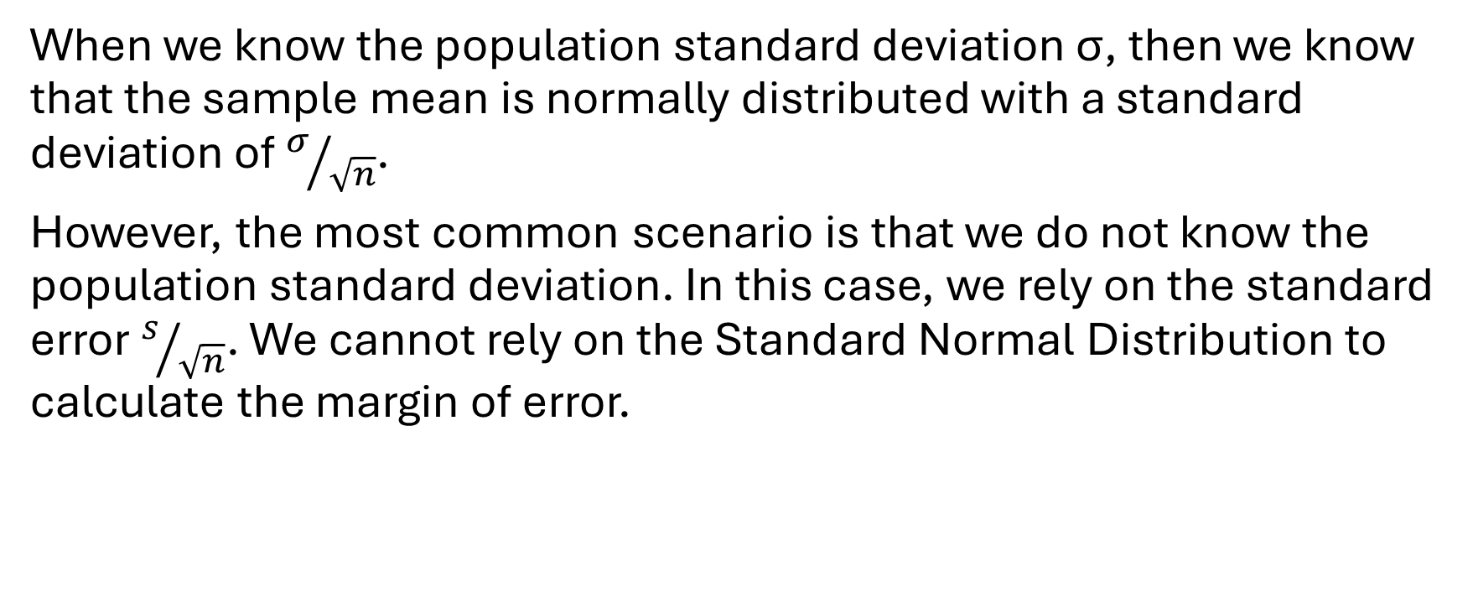
Confidence Intervals for Means (σ NOT known)
When we know the population standard deviation σ, then we know that the sample mean is normally distributed with a standard deviation of $σ/{\sqrt{n}}$.
However, the most common scenario is that we do not know the population standard deviation. In this case, we rely on the standard error $s/{\sqrt{n}}$. We cannot rely on the Standard Normal Distribution to calculate the margin of error.

Slide 16
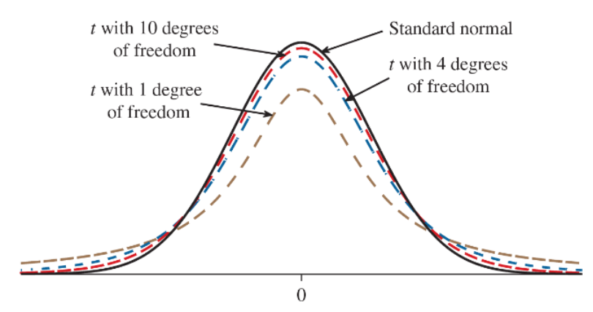
The Student’s t-distribution
There are many distributions under this
category. Each one is unique depending on
a value called the degrees of freedom:
df = n - 1
These distributions are symmetric and
unimodal, but they are more spread out
than the standard normal distribution.
To use this method, the sample size n must be > 30 or we must know that the sample came from a normal population.
SciShow Video

Slide 17
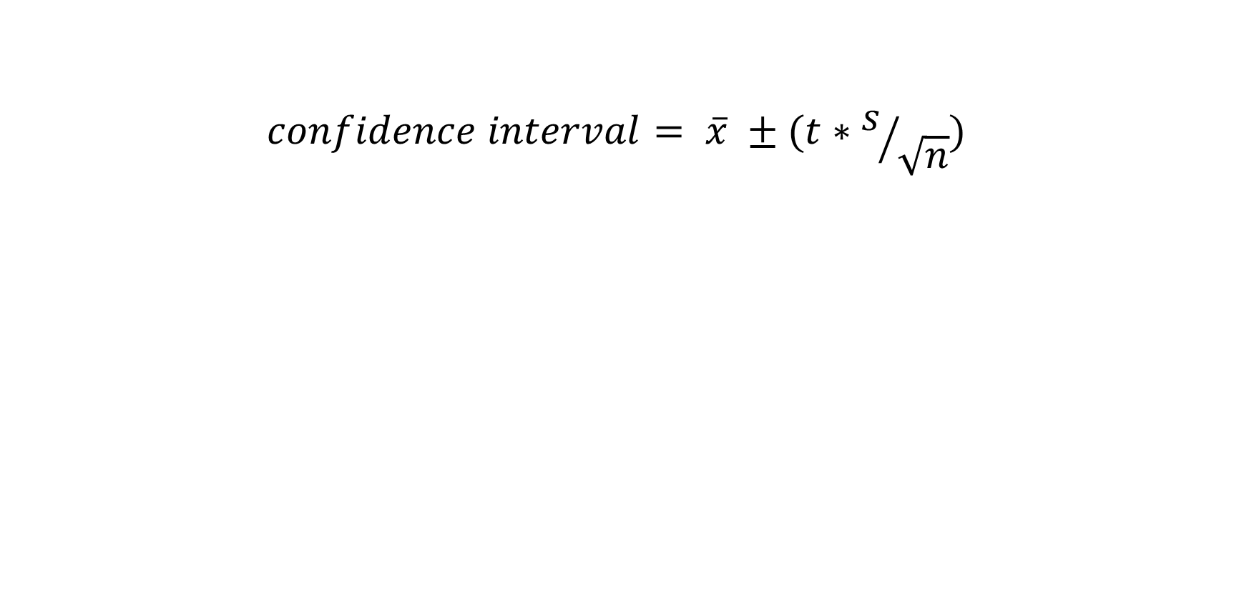
T-Intervals for Means
$$confidence interval= \overline{x} ±(t∗s/{\sqrt{n}})$$

Slide 18
Test Scores Example
To test a new method of teaching vocabulary, education researchers give a vocabulary test to 40 sixth-graders. The sample mean test score was 88.4 with a standard deviation of 7.2. Construct a 95% confidence interval to estimate the population mean test score.

Slide 19
Test Scores Example Solution
To test a new method of teaching vocabulary, education researchers give a vocabulary test to 40 sixth-graders. The sample mean test score was 88.4 with a standard deviation of 7.2. Construct a 95% confidence interval to estimate the population mean test score.
confidence interval = (86.10, 90.70)
We are 95% confident that the population mean test score is between 86.10 and 90.70 percent.

Slide 20
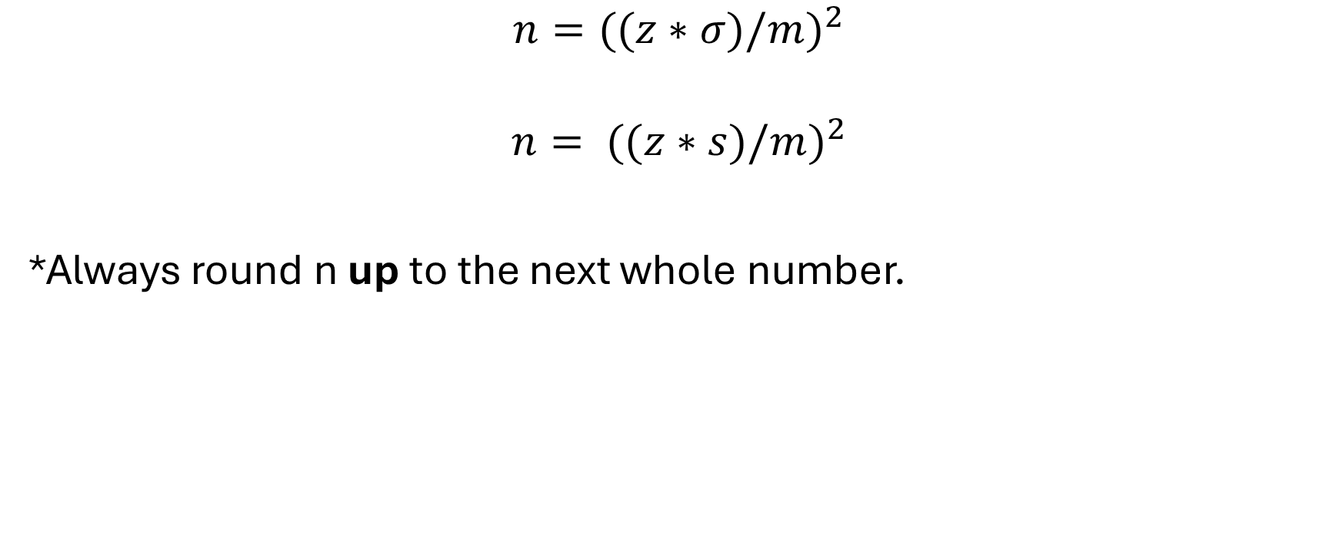
Calculating a Minimum Sample Size
$$n=({(z∗σ)/m)}^{2}$$
$$n= {((z∗s)/m)}^{2}$$
*Always round n up to the next whole number.

Slide 21
Weighing Mice Example
Scientists want to estimate the mean weight of mice after they have been fed a special diet. In a previous study, a sample of 60 mice was weighed, and the sample standard deviation was 3 grams. Estimate the number of mice to be weighed to build a 95% confidence interval with a margin of error of 0.5 grams.

Slide 22
Weighing Mice Solution
Scientists want to estimate the mean weight of mice after they have been fed a special diet. In a previous study, a sample of 60 mice was weighed, and the sample standard deviation was 3 grams. Estimate the number of mice to be weighed to build a 95% confidence interval with a margin of error of 0.5 grams.
We need to weigh at least 139 mice in the next study to achieve a margin of error of 0.5 grams.

Slide 23
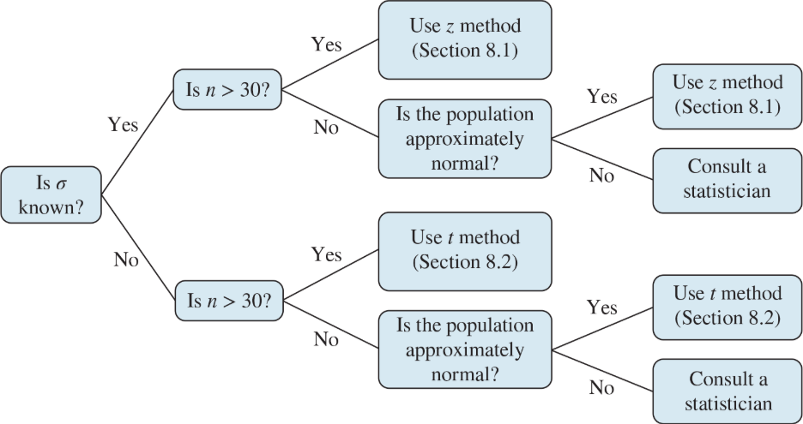
Choosing a Method for Means

Slide 24
Confidence Intervals for Proportions
Conditions:
The sample must be a SRS.
The population is at least 20 times as large as the sample.
The items in the population are divided into two categories
(p and not p).
To use a normal approximation, we have to have a sample size that meets the following conditions:
np ≥ 10 and n(1-p) ≥ 10

Slide 25
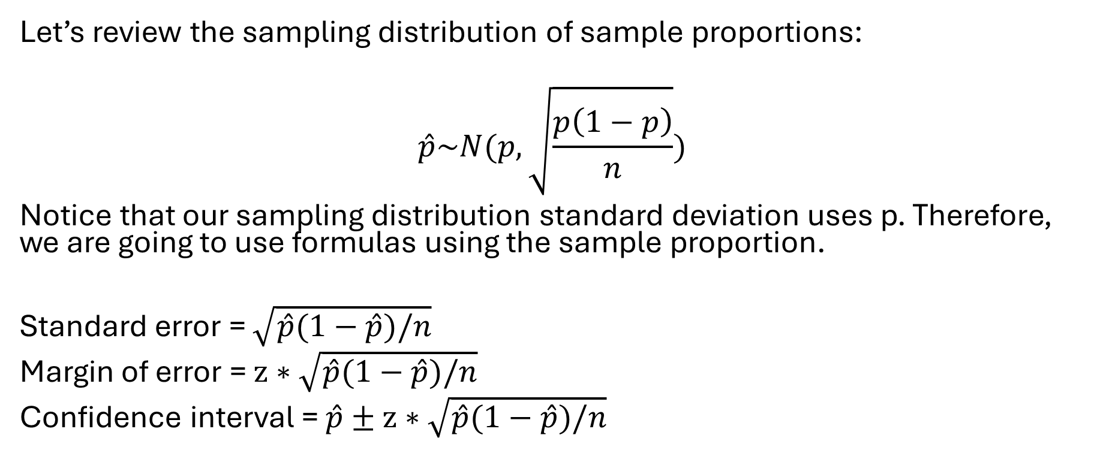
The Standard Error
Let’s review the sampling distribution of sample proportions:
$$\hat{p}\sim N(p, \sqrt{\frac{p\left(1−p\right)}{n}})$$
Notice that our sampling distribution standard deviation uses p. Therefore, we are going to use formulas using the sample proportion.
Standard error = $\sqrt{\hat{p}(1−\hat{p})/n}$
Margin of error = $z∗\sqrt{\hat{p}(1−\hat{p})/n}$
Confidence interval = $\hat{p}±z∗\sqrt{\hat{p}(1−\hat{p})/n}$

Slide 26
Candy Example
A group of 90 product testers received bags of different flavored candies. We want to build a 92% confidence interval for the population proportion of people who prefer the lime-flavored candy. 14 of the testers labeled the lime as their favorite flavor.

Slide 27
Candy Example Solution
A group of 90 product testers received bags of different flavored candies. We want to build a 92% confidence interval for the population proportion of people who prefer the lime-flavored candy. 14 of the testers labeled the lime as their favorite flavor.
confidence interval = (0.0887, 0.2224)
We are 92% confident that the population proportion of people who favor the lime is between 0.0887 and 0.2224 (or between 8.87% and 22.24%).

Slide 28
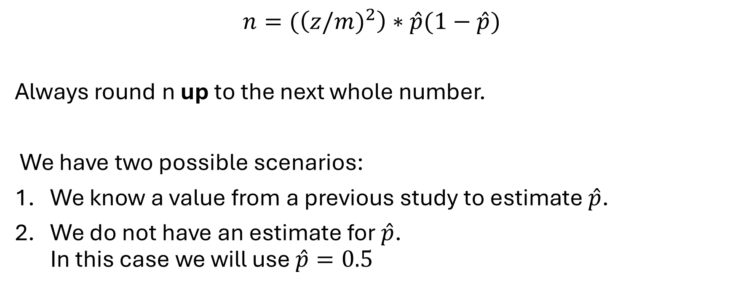
Calculating a Minimum Sample Size for Proportions
$$n=(\left({z/m)}^{2}\right)∗\hat{p}(1−\hat{p})$$
Always round n up to the next whole number.
We have two possible scenarios:
We know a value from a previous study to estimate $\hat{p}$.
We do not have an estimate for $\hat{p}$.
In this case we will use $\hat{p}=0.5$

Slide 29
Polling Example
A pollster wants to construct a 95% confidence interval for the proportion of adults who believe that economic conditions are getting better. What sample size is needed to obtain a margin of error of 3%?
A pollster wants to construct a 95% confidence interval for the proportion of adults who believe that economic conditions are getting better. A poll taken five years ago estimates this proportion to be 0.28. What sample size is needed to obtain a margin of error of 3%?

Slide 30
Polling Example Solutions
A pollster wants to construct a 95% confidence interval for the proportion of adults who believe that economic conditions are getting better. What sample size is needed to obtain a margin of error of 3%? We need to poll at least 1,068 people.
A pollster wants to construct a 95% confidence interval for the proportion of adults who believe that economic conditions are getting better. A poll taken five years ago estimates this proportion to be 0.28. What sample size is needed to obtain a margin of error of 3%? We need to poll at least 861 people.

Slide 31
Mixed Practice for One-Sample Confidence Intervals
A certain soft drink bottler wants to estimate the proportion of its customers that drink another brand of soft drink on a regular basis. A random sample of 100 customers yielded 18 who did in fact drink another brand of soft drink on a regular basis. Compute a 98% confidence interval to estimate the proportion of interest. Include margin of error calculations.
A company has developed a new type of light bulb and wants to estimate its mean lifetime. A simple random sample of 101 bulbs had a sample mean lifetime of 750.2 hours with a standard deviation of 30 hours. Construct a 90% confidence interval for the population mean lifetime of all bulbs manufactured by this new process. What are two things that could cause this interval to be wider?

Slide 32
Practice continued
Assume that we want to estimate the mean IQ score for the population of statistics students. How many statistics students must be randomly selected for IQ tests if we want 95% confidence that the sample mean is within 3 IQ points of the population mean? Assume a population standard deviation of 15.
In a sample of 400 American adults, it was found that 45% reported that they have confidence in their physician. Find a 99% confidence interval for the proportion of American adults who have confidence in their physician.
A simple random sample of 200 third-graders in a large school district was chosen to participate in an after-school program to improve reading skills. After completing the program, the children were tested, and 142 of them showed improvement in their reading skills. Construct a 95% confidence interval for the proportion of third-graders in the school district whose reading scores would improve after completing the program. Is it reasonable to conclude that more than 60% of the students would improve their reading scores after completing the program? Explain.

Slide 33
Practice continued..
Boxes of cereal are labeled as containing 14 ounces. Below are the weights, in ounces, of a sample of 12 boxes (it is reasonable to assume that the population is approximately normal).
14.02 13.97 14.11 14.12 14.10 14.02 14.15 13.97 14.05 14.04 14.11 14.12
Construct a 98% confidence interval for the mean weight. The quality control manager is concerned that the mean weight is actually less than 14 ounces. Based on the confidence interval, is there a reason to be concerned? Explain.
In a study of the accuracy of fast-food orders, one popular chain had 254 accurate orders and 46 that were inaccurate. Construct a 90% confidence interval to estimate the population proportion of inaccurate orders.

Slide 34
Practice continued…
A community wants to conduct a study to see how many middle school kids plan to trick or treat for Halloween. How many kids should be surveyed if we want a margin of error of 8% and a confidence level of 90%?
A large city plans to survey business owners to determine the percentage of satisfaction with the transit system. A similar study conducted 5 years ago found that only 31% of the business owners were satisfied with the transit system. If we want to have a margin of error of 5%, how many business owners should be surveyed to find a 99% confidence interval?
A professor wants to conduct a study regarding student prerequisite knowledge for College Algebra. She studies the placement test scores and is told that the population standard deviation is 6.72. How many students would she need for her study if she wants to build a 95% confidence interval with a margin of error of 2 points?

Slide 35
Practice continued….
We want to find the population mean pulse rate for adults. If we know the population standard deviation is 12.5 bps (beats per second), what sample size is needed to obtain a 99.9% confidence interval with a margin of error of 2.1?
In a sample of 40 adults on a popular weight loss program, the mean weight loss was 2.1 pounds with a standard deviation of 4.8 pounds. Construct a 90% confidence interval to estimate the population mean weight loss for this diet.

